Slide 1
Network Optimization Using Structural Simulation Toolkit
Sara Karamati

Slide 2
Agenda
Structural Simulation Toolkit (SST) overview
Network optimization using SST
Latency and bandwidth optimization
Topology optimization

Slide 3
The Structural Simulation Toolkit
A discrete-event simulation framework
A fully modular design
Enables extensive exploration of an individual system parameter without the need for intrusive changes to the simulator
Parallel simulation environment based on MPI
Provides a high level of performance and the ability to look at large systems

Slide 4
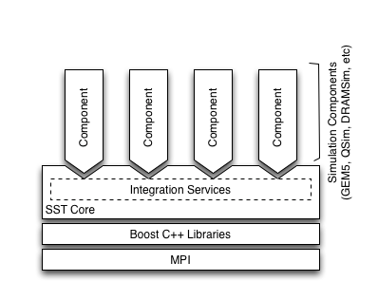
Capabilities
SST Core (framework):
Time-scale independent: micro-, macro-scale simulations
Provides interfaces and utilities for simulation models
Components: SST’s simulation models
Components perform the actual simulation
Many built-in models available: processors, memory, network
Compatible with external models: Gem5, DRAMSim2, many others

Slide 5
Key Parts
Component is a simulation model
Link connects two components. Each link has a minimum latency
Components use link to communicate by passing Events
Components use an Event handler to handle events sent over a link
Clock handler is triggered by a clock

Slide 6
Component
Basic building block of a simulation model
E.g., processor, cache, network router, etc.
Performs the actual simulation
Uses Links and Ports to communication with other components
Components define ports, links connect ports between components
Polled: Register a clock handler to poll the link
Interrupt: Register an event handler to be called when an event arrives
Both: Receive events on interrupt, send events on clock

Slide 7
Element Libraries
SST comes with many built-in libraries
Processors
Memory
MemHierarchy – Caches, memory
VaultSimC - Stacked memory
Network, etc.
Also compatible with many external “libraries”
DRAMSim2, Gem5, many others

Slide 8
SST MPI Communication Stack

Slide 9
Ember: Network traffic generator
Light-weight endpoint for modeling network traffic
Enables large-scale simulation of networks where detailed modeling of endpoints would be expensive
Scales to 1 million nodes
Supports multiple “cores” per node
Example motifs are available for:
2D and 3D Halo communications
Sweeping communications like Sweep3D
3D-FFT
Basic MPI Collectives including Reductions, Gathers and All-to-All
…

Slide 10
Example Motif
bool EmberRingGenerator::generate( std::queue<EmberEvent*>& evQ ) { enQ_compute( evQ, nsCompute ); int to = mod( rank() + 1, size()); int from = mod( (signed int) rank() - 1, size() ); if ( 0 == rank() ) { enQ_send( evQ, m_sendBuf, m_messageSize, CHAR, to, TAG, GroupWorld ); enQ_recv( evQ, m_recvBuf, m_messageSize, CHAR, from, TAG, GroupWorld, &m_resp ); } else { enQ_recv( evQ, m_recvBuf, m_messageSize, CHAR, from, TAG, GroupWorld, &m_resp ); enQ_send( evQ, m_sendBuf, m_messageSize, CHAR, to, TAG,GroupWorld );} if ( ++m_loopIndex == iterations ) { return true; } else { return false; } }

Slide 11
Simulating Large Networks
A network node consists of
Driver (the “application”)
NIC
Router
Nodes are connected together via the routers to form the network
High radix router model
Topologies – mesh, n-dim tori, fat-tree, dragonfly
Firefly is the interface between the driver and the router

Slide 12
Motivation
Compute is getting cheaper, communication is the bottleneck
Traditional benchmarks (such as LINPACK) are compute heavy
Not representative of modern practical computational loads, which are much heavier on communication
Need to identify the communication demands of modern applications to design appropriate hardware

Slide 13
Latency and Bandwidth Optimization

Slide 14
Problem
Given an application code, find the optimal network configuration (latency, bandwidth)
Optimality Objective
Minimize cost based on a predefined cost model. Cost model can be a function of the latency, bandwidth, number of nodes, etc.
Optimality condition:
Run time within a set tolerance limit of the fastest configuration

Slide 15
Search Methods
Black-box optimization problem
Knowledge about the objective function is obtained by sampling
No gradient information
Exhaustive search
Impractical for simulating large
systems and large search spaces

Slide 16
Cost greedy search algorithm

Slide 17
Cost greedy search algorithm

Slide 18
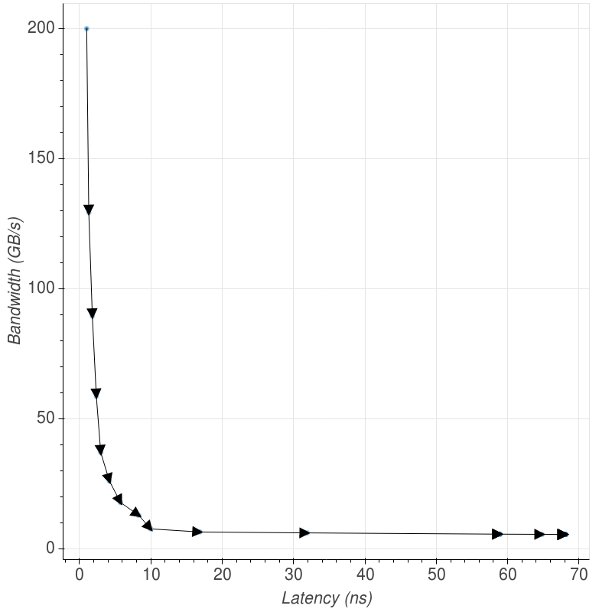
Simulation Results

Slide 19
Golden Section Search (GSS)
Finding the point with minimum cost by successively narrowing the range of possible values.
c = b - (b - a) / 1.6 d = a + (b - a) / 1.6

Slide 20
Search Methods: Performance Results
 | Exhaustive Search |  |  | Greedy + GSS
 | Grid size = c | Grid size = c/2 | Grid size =c/10 | Greedy | Greedy + GSS (error < e) | Greedy + GSS (error < e/10)
SST calls | 285 | 523 | 2633 | 57 | 236 | 560
Cost saving | 778 | 809 | 817 | 802 | 816 | 824

Slide 21
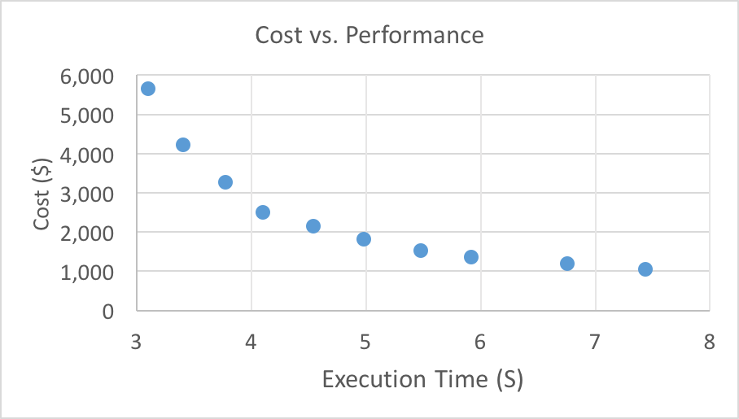

Cost versus Performance
Cost model per link: $\frac{6×{10}^{−6}}{Latency (s)}$ $+ 30\text{× }\text{bandwidth}\text{ (}\text{GB}\text{/}\text{s}\text{)}$
Tolerance limit
Number of iterations
Network configuration
Topology: fat tree
Number of nodes: 128
Motif: FFT3D
FFT input size: 256³

Slide 22
Topology Optimization

Slide 23

Problem
$$\min{exection time}$$
$$s.t.$$
$$N≥10000$$
$$network cost<C$$
N Number of network compute nodes
C Budget
Two network configurations are studied:
Folded Clos
Dragonfly
Building Blocks | Cost ($)
100-TFLOPs node | 3000
12-port switch | 160
24-port switch | 320
36-port switch | 480
48-port switch | 640
60-port switch | 800
NIC-switch cable | 50
Switch-switch cable | 200

Slide 24
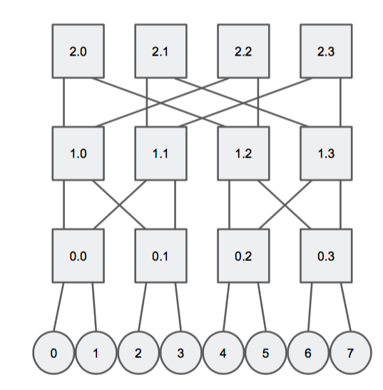
Folded Clos (Fat Tree) Topology
k = router radix / 2
n = number of stages
N = k^{n}
R = nk^{n-1}
http://web.stanford.edu/class/ee382c/lectures/03_topology.pdf

Slide 25
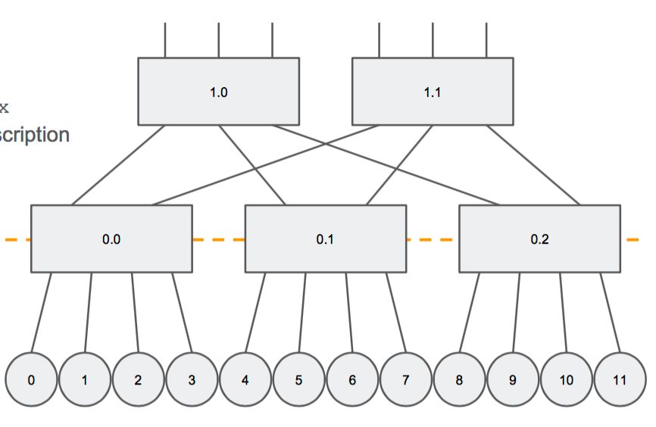
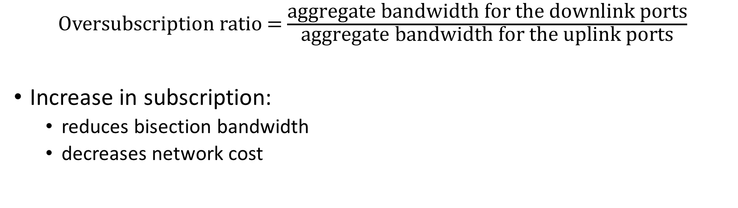
Folded Clos Topology: Oversubscription
Oversubscription ratio = $\frac{\text{aggregate} \text{bandwidth} \text{for} \text{the} \text{downlink} \text{ports}}{\text{aggregate} \text{bandwidth} \text{for} \text{the} \text{uplink} \text{ports}}$
Increase in subscription:
reduces bisection bandwidth
decreases network cost

Slide 26
Oversubscription and Switch Optimization
Lower oversubscription is desirable for performance
For every switch type: Find minimum over_sub where: network_cost(over_sub, N, switch_type) < C

Slide 27
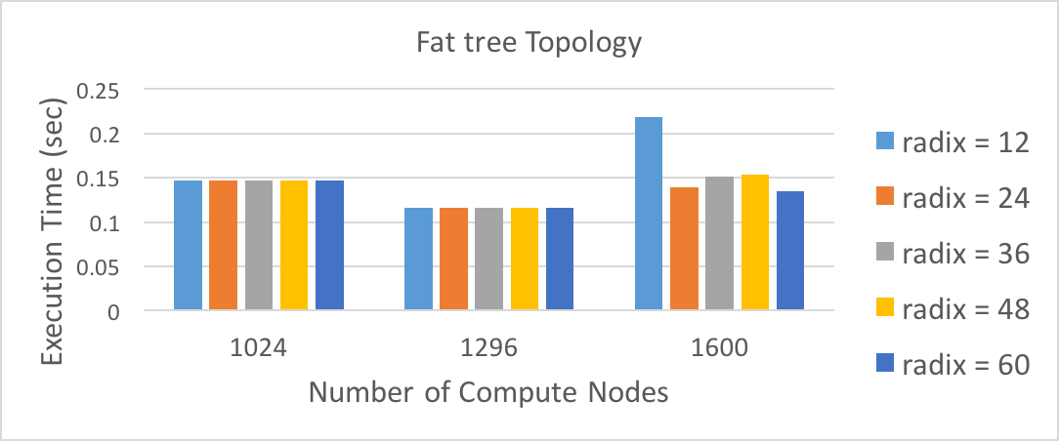
Oversubscription and Switch Optimization
Motif: FFT3D
Input size : 2048³

Slide 28
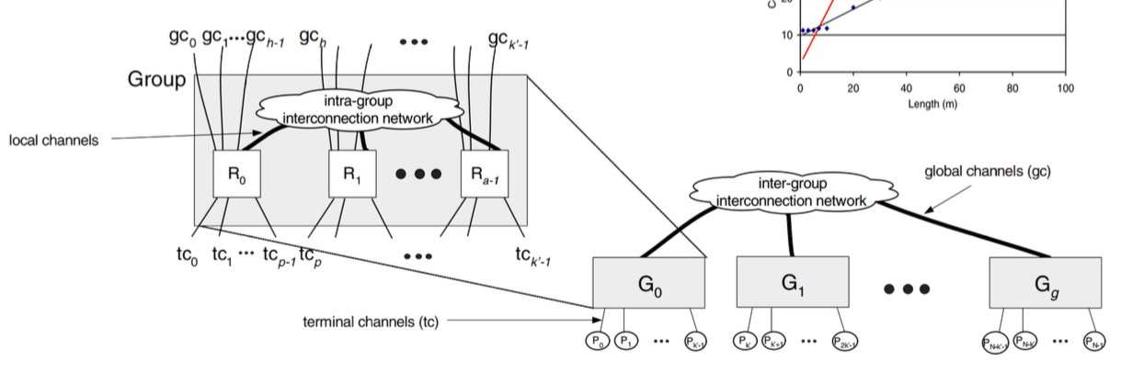
Dragonfly Topology
N Number of compute nodes
p Number of compute nodes connected to each router
a Number of routers in each group
h Number of channels within each router used to connect to other groups

Slide 29
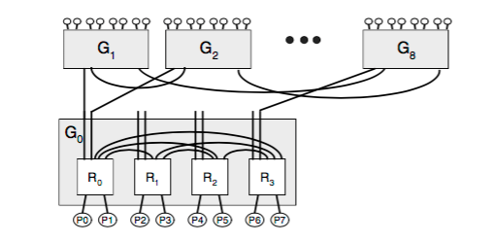
Dragonfly Topology
number of groups = (ah + 1)
number of routers = (number of groups) × a
N = (number of routers) × p
N Number of compute nodes
p Number of compute nodes connected to each router
a Number of routers in each group
h Number of channels within each router used to connect to other groups

Slide 30

Dragonfly Switch Optimization
First dimension bisection bandwidth: bb_1D = $\frac{a2 (ah+1)}{4p}$
Second dimension bisection bandwidth: bb_2D = $\frac{\left(ah+1\right)2}{4p}$
Bisection bandwidth = min (bb_1D, bb_2D)
S = set of possible configurations For h in range(1, 60) For p in range(1, 60-h) Find a where (ah+1)ap ≥ N If (a + h + p)≤ 61 and network_cost(a,h,p) < c Add (h, p, a) to S Choose a configuration from S with maximum bisection bandwidth

Slide 31
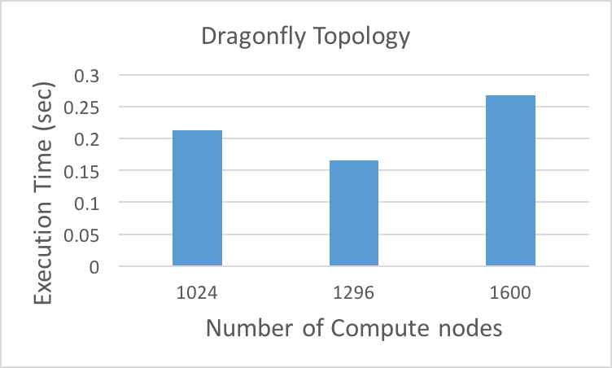
Network Optimization

Slide 32
Thank You!

